Slide 1
KV6002 – Terms of Reference
Group 21

Slide 2
True North Surf Club
True North Surf Club is an independent Surf Club that is affiliated with Surfing England, and is based in North Tyneside. They have recently approached us with the request to design and develop a slick, functional website for the surf club, which includes the following features:
- A gallery page to showcase their images (incl. image classification???).
- A contact form to provide a means of contacting the club.
- A membership sign up page, allowing potential new members to sign up for membership.
- An e-commerce page so that branded merchandise can be purchased from the club via the website.
- A members only page to allow members of the club access to special information and discounts on the shop items.
The team assigned to fulfil these requests consists of 5 members: Ben Kelly, Adrian Kucia, Kalina Filipowicz, Edward Davies and Charlie Callister.
The requirements for this project were largely gathered via the initial project brief, with further requirements, such as a minimalistic design, coming to light as we further investigated what the client’s needs truly required via a meeting with the client. This investigation process allowed us to refine the identified requirements even further, assessing that the client also required integration of a Google Form within the site, as well as a Google Calendar present in the members only page. Also included in the client meeting was the need for the senior members of the club to be easily able to update the page without requiring any knowledge of the website’s code.

Slide 3
Epic
For: [The user group] Who: [Problem] Our: [Type of system] Is a: [Outline project idea] That: [How it solves the problem] | True North Surf Club members and potential affiliates Need to find out more about the club & buy merch Website Is a hub for members of the surf club Will provide information, show club images, provide a means of purchasing products and allow users to sign up for membership.

Slide 4
Slides 2&3
- Team plan, outlining how features work together as a plan.
- Plan should include:
The overall system in which we will be developing is a functioning, modern website that includes a sufficient level of security as well as various pages to match the various different requirements. These pages can be compartmentalised into 5 different sections: a home page, a gallery page, a membership sign up page, a contact form, a members only page and a shop page.
These pages can be split into various subsystems, which will be assigned to each member of the team. The subsystems will be split as follows: Ben – Subsystem1, Adrian – Subsystem2, Kalina – Subsystem3, Edward – Subsystem4, Charlie – Subsystem5.
The system will be tested continuously throughout the development process and logged accordingly, ensuring that the system is robust enough for deployment.
The subsystems will all possess standalone functionality but will integrate with each other on the site as required, creating a dynamic page that is visually pleasing to look at.
In order for the development of the website to take place, certain software is required. This includes an IDE to write the code in as well as a web server to host the PHP files on. A database may also be necessary after correspondence with the client.
Due to the nature of the website being in the public domain, we must ensure that the website’s security is up to standard so that the client’s data is never at risk. This will be done by strictly following coding security standards to ensure no malicious attacks can take place. Not only this, but as this website is being handed over to a client, we must ensure that it is of a sufficient quality, in terms of appearance as well as functionality.
Change these subsystem names once allocated

Slide 5
Slide 4
Intended users – 1 persona per group member

Slide 6
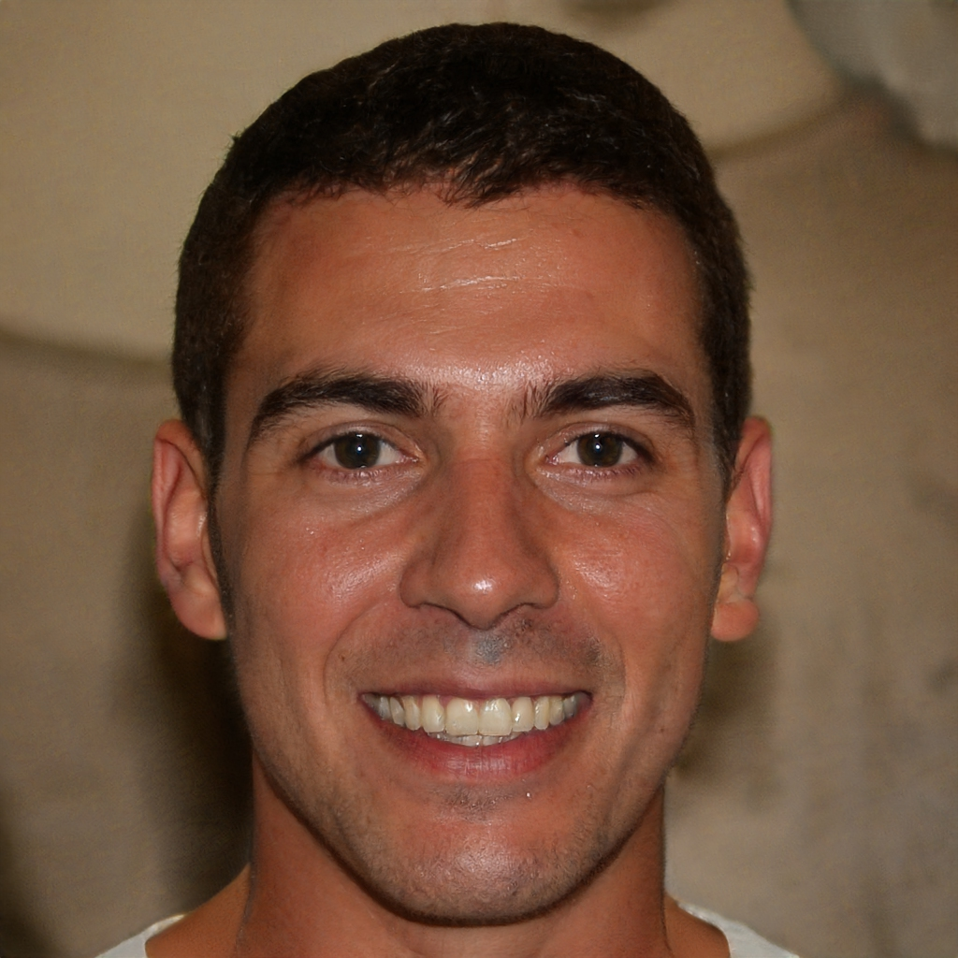
Persona #1 – Ricky Smith
“I love anything and everything outdoors! I’m always looking for new adventures to go on, or exciting things to do!”
About Ricky
Ricky is a 38-year-old rock climbing instructor who is known for his adventurous and spontaneous nature. Despite his love for outdoor activities and adrenaline rushes, he struggles with technology and is not very tech-savvy. As a rock climbing instructor, he inspires others to conquer their fears and push their limits while also enjoying the beauty of nature.
What types of websites/apps does Ricky use regularly?
Ricky does not spend too much time on the internet or his phone, as he is usually doing something outdoors. He does however, use Amazon to purchase various items for his rock-climbing job so he is somewhat familiar with e-commerce sites. He also enjoys watching Netflix on his mobile phone whilst travelling on the train to and from work. Due to his active lifestyle, Ricky also owns a Fitbit to track his movement goals.
Requirements
Ricky requires a site he uses to not be overly complicated, as to not frustrate him if he can’t find what he is looking for on the site. He likes Amazon and Netflix because their designs are clean and intuitive.
KNOWLEDGE AND SKILLS
Interest in surfing
Spontaneity
Technology Literacy
DEMOGRAPHICS
Age: | 38
Job: | Rock-climbing instructor
Location: | Whitley Bay
Salary(£-£££) | £/££
TECHNOLOGY USE
iPhone 8
Amazon
Netflix
Fitbit

Slide 7
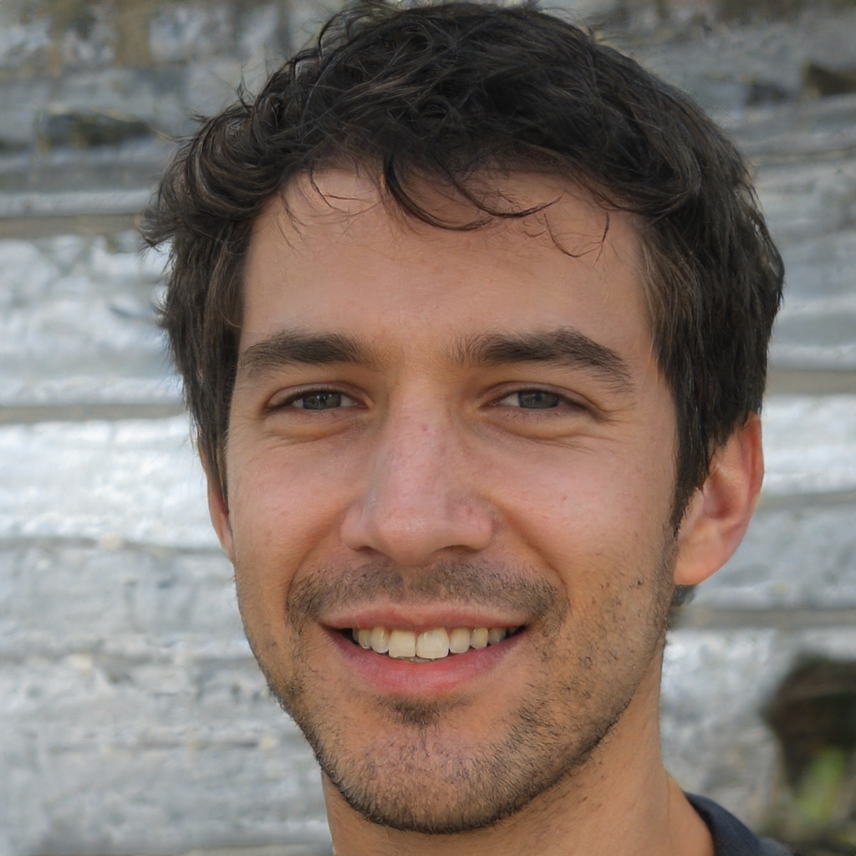
Persona Fredrick Jones
“My favourite way to spend my free time is on the beaches with my friends. Since moving to University, I have struggled to find a community. ”
About Fredrick
Fredrick is a 21-year-old university student who studies full time and is part of the university lacrosse team. He is an outgoing and active person who thrives of human interaction and new situations. Fredrick enjoys the outdoors and hates being cooped up inside. He is a well-travelled individual who seeks new adventures. His course at university is suited to his interests and needs as he studies geology.
What types of websites/apps does Fredrick use regularly?
Fredick frequents on social apps and websites such as Facebook, NU Connect, Twitter, Snapchat and Instagram. He also uses e-commerce websites such as amazon, ASOS and other clothing retailers. He utilises Amazon prime for TV shows and films and actively uses YouTube for shorter entertainment needs. For his active lifestyle Fredrick uses apps such as Strava to track his twice weekly 5km runs, and he uses IOS Health app to track his heart rate and steps.
Requirements
Fredrick requires a site which is not too dissimilar to the ones he currently uses, therefore they need to be simplistic and intuitive allowing a simple signing in and up process and the information gain from the site to not be too heavy in information.
KNOWLEDGE AND SKILLS
Interest in surfing
Spontaneity
Technology Literacy
TECHNOLOGY USE
Words
Age: | 20
Education: | Bachelors Student
University: | Northumbria
Salary(£-£££) | £
Technology Use
I-Phone XR
University Computers
I-Pad
MacBook Air 2016
Apple Watch

Slide 8
Persona #2
Intended users – 1 persona per group member

Slide 9
Persona #3
Intended users – 1 persona per group member

Slide 10
Persona #4
Intended users – 1 persona per group member

Slide 11
Persona #5
Intended users – 1 persona per group member

Slide 12
Slide 5 onwards
- Clear outline of the subsystem we are working on.
- 5 User stories (should be connected to each persona).
As a <role> I want <something> so that <benefit>.
- A clear outline of the tasks we intend to complete and the deliverables.

Slide 13
User Story #1 – Ricky Smith
As an outdoor activities enthusiast, I want to be able to easily get in contact with the club so that I can join the club and get involved in their activities.

Slide 14
User Story: Fredrick Jones
As a new member of the Newcastle Upon Tyne community I would like somewhere to be able to go and surf as I have always wanted to try. I would also like to meet new people while doing so, this would allow me to build bigger circles as I currently only talk and interact with a handful of my course mates and flat mates.
I have also made friends with an Erasmus student from Portugal who is an avid surfer and wants to see what the north of England's beaches have to offer during his time in the UK. With this friend I would like to meet with other avid surfers from the UK to show him what us Brits have.

Slide 15
User Story #3

Slide 16
User Story #4

Slide 17
User Story #5

Slide 18
Tasks and Deliverables
Tasks
Create a minimalist, sleek Home page, with navigation to other pages.
Create a functioning Gallery page.
Create a functioning Contact page including a means of signing up to the club.
Create a members only section of the site, which includes discounts for members on shop items as well as member’s only news and photos.
Create an e-commerce page, allowing the club to sell their merchandise.
Consistently style page, to a sufficient standard.
Deliverables
A functioning website that contains each of the above pages.
Deliverable 2
Deliverable 3
Deliverable 4
Deliverable 5

